Slide 1

Solely for the purpose of Forage Work Experience
Web Scraping to gain company insights

Slide 2
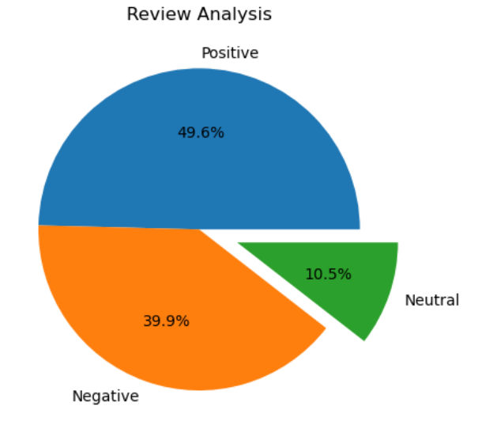
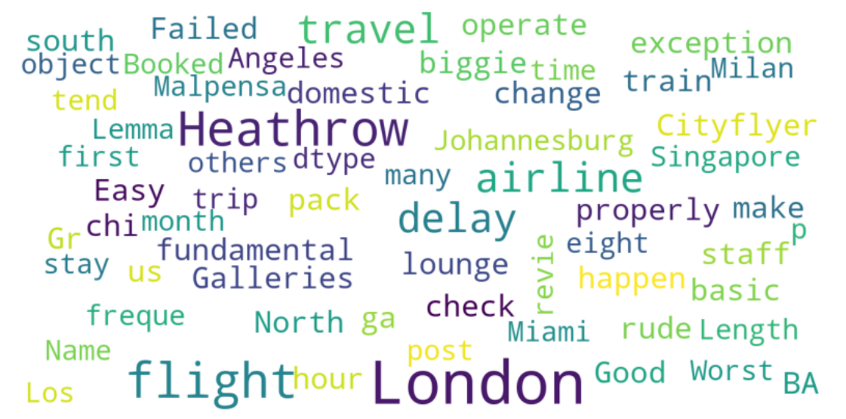
Solely for the purpose of Forage Work Experience
Analysis Of Customer Reviews
After Reviewing 100 reviews given by the customers, we obtained
Positive Reviews : 496
Negative Reviews : 399
Neutral Reviews : 105
WordCloud Obtained:

